Slide 1
Edge Security Bootcamp
OAuth Introduction

Slide 2
OAuth overview
OAuth v2.0
is a protocol that allows clients to grant access to server resources to another entity without sharing credentials
Client IDs and Secrets
are used to identify and authenticate applications (application's consumer key and consumer secret)
Tokens
are issued to allow access to specific resources for a specified period of time and may be revoked by the user that granted permission or by the server that issued the token
Scopes
can be used to limit the access for a given token, granting permission only for the operations that are necessary
Grant Types
4 different Grant Types specify the different authentication usage scenarios OAuth supports
TLS
Tokens must be protected, and OAuth 2.0 requires that all API traffic be sent via TLS

Slide 3
Access tokens
Access Tokens allow access to a protected resource for a specific application to perform only certain actions for a limited period of time.
In Edge, access tokens are opaque strings with no encoded meaning. Access tokens are passed as Bearer tokens in an Authorization header.
Identification info from the requesting application (client ID and secret)
+
Resource owner credentials (optional: user of the app)
+
Optional information about what the application wants to do with the resource (scope)
=
Access Token and (optional) refresh token

Slide 4
Refresh tokens
Refresh Tokens, if provided, represent a limited right to reauthorize the granted access by obtaining new access tokens.
In Edge, refresh tokens are opaque strings with no encoded meaning.
Identification info from the requesting application (client ID and secret)
+
Refresh token
+
Optional information about what the application wants to do with the resource (scope)
=
Access Token

Slide 5
Scopes
Scopes identify what an application can do with the resources it is requesting access to.
Scope names are defined by the authorization server and are associated with information that enables decisions on whether a given API request is allowed or not.
When an application requests an access token, the scope names are optional
Edge associates scope names to be matched with a combination of API resource path and verb. So, for example:
Scope 1: “READ”
GET /photos
GET /photos/{id}
Scope 2: “UPDATE”
GET /photos
GET /photos/{id}
POST /photos
PUT /photos/{id}

Slide 6
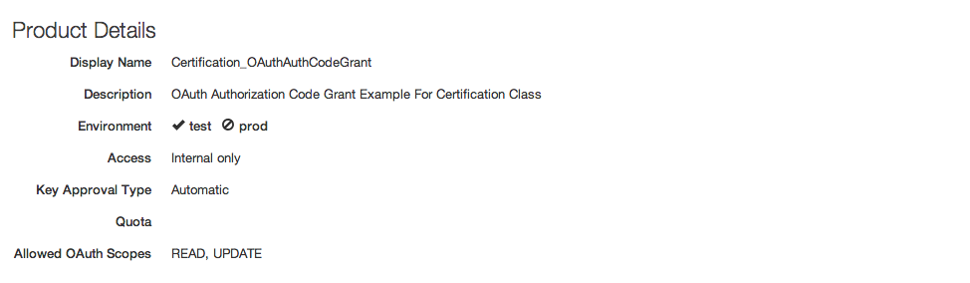
Scopes
The OAuth spec allows for an app to specify no scope on a token request, in which case you should either:
assign a default scope or no scopes (the usual case), or
reject the request
One or more scopes can be specified in the API Product definition

Slide 7
OAuth grants
An OAuth Grant is a credential representing the resource owner’s authorization. More often than not, we tend to think of grants in terms of the process used to obtain an access token.
Grant Type | Typical Use Case | Complex?
No specific resource owner is involved
Client Credentials | Business system interactions, where resources being operated on are owned by the partner, not a particular user | No
A specific resource owner is involved
Resource Owner Password Credentials | Resources are owned by a particular user and the requesting application is trusted | A bit
Authorization Code | Resources are owned by a particular user and the requesting application is untrusted | Very
Implicit | Resources are owned by a particular user, and the requesting application is an untrusted browser-based app written in a scripting language such as JavaScript | Very complex, and less secure than Auth Code

Slide 8
THANK YOU

